Slide 2
Welcome Parents We are excited to welcome your child to Kindergarten at PRIDE ELEMENTARY!

Slide 3
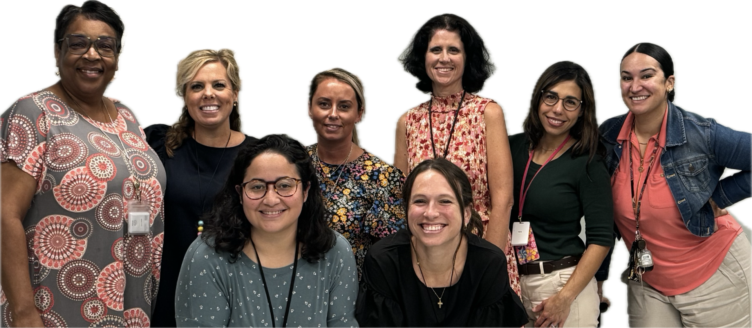
Meet your Principals and Kindergarten Teachers Paulette English, Principal Heather Moncrief, Assistant Principal Mrs. Dawn Harris Mrs. Alyson Gavin Mrs. Nicole Mendoza Mrs. Fonda Toliver Mrs. Elizabeth Feito Ms. Nicole Cedeno Mrs. Jennifer Garlinghouse Mrs. Giselle Outerbridge Paraprofessionals-Faith Jeffrey, Reena Sharma, and Sangeetha Prabakaran

Slide 4
Important Contact Information
School Phone Number: (813) 558-5400
School Email Address: pride.elementary@hcps.net
School Website: https://www.hillsboroughschools.org/pride
School Hours: 7:40 – 1:55. Students are encouraged to arrive when classroom doors open at 7:10.
(Designated Mondays – Early Release at 12:55)

Slide 5
Important Information
School Lunch Program
Online Registration: https://www.hillsboroughschools.org/Page/3734
Arrival and Dismissal Procedures
Options: car rider, walker, bike rider, HOST, bus, or daycare
Bus Information
Only available for K-Bar Ranch families living 2+ miles from school
HOST Before/After School Care
Online Registration: https://www.hillsboroughschools.org/host
Uniforms
TOPS: white, navy, or maroon polo shirts
BOTTOMS: khaki or navy shorts, pants, dresses, skirts, or skorts
SPIRIT SHIRTS -available for purchase from PTA
https://pridetampa.memberhub.com/store?limit=21&live=true
Health Conditions- contact school nurse when registering

Slide 6
Kindergarten Readiness
Is My Child Ready For Kindergarten?
Kindergarten Readiness checklist (English)
Kindergarten Readiness checklist (Spanish)
Academic Expectations of a Kindergarten Student
B.E.S.T. ELA Standards
B.E.S.T. Math Standards
Science Florida Standards
Social Studies Florida Standards

Slide 7
Steps to Enrollment
A parent/legal guardian must complete the registration process and provide the proper documents to the school site where the child will attend.
Your child can attend kindergarten in August as long as he or she turns 5 on or before September 1.
Your child is zoned for a particular elementary school based on your address. Find your assigned school.
For parents who wish to send their child to a school outside of their zoned area, see our choice options.

Slide 8
Documents needed for enrollment
What forms do I need to complete?
Student Enrollment Record Form - SER (provided at the school site or electronically)
Student Residency Form – can be completed ahead of time, supporting documentation is required

Slide 9
Documents needed for enrollment (Continued)
What supporting documents do I need to register for kindergarten?
Birth certificate
Social security card, if available
Florida Physical HRS Form -- Florida Physical HRS form supplied by a doctor dated within 12 months prior to entry in Florida Schools (first day of school)
Florida Immunization Record on HRS hard card (form #680) supplied by a doctor
Two forms of verification of address that prove where you live but are NOT your driver’s license or state-issued ID card (some examples are a utility bill, lease, or a contract to purchase a home)
If a child lives with someone who is not a parent, you may also need to complete a student resident form, which is available at the school
All documents above must be submitted to register your child!

Slide 10
Submitting Registration Forms and Documentation
Completed forms and supporting documentation should be submitted to the main office on Tuesdays or Thursdays from 9:00-11:00.
If you are unable to submit forms and supporting documentation on the designated days above, call (813) 558-5400 to schedule an appointment.

Slide 11
A Typical Day
Arrival
Morning Work
Morning Meeting
UFLI Phonics (30 minutes)
ELA-English Language Arts (90 minutes)
Lunch (30 minutes)
Social Studies (30 minutes)
Recess (20 minutes)
Math (85 minutes)
Science (60 minutes)
Snack/Social Centers (30 minutes)
Dismissal

Slide 12
Let's Take a Tour!
Link To This Presentation

